Slide 1


UNIVERSITY COLLEGE OF ENGINNERING,
OSMANIA UNIVERSITY
PUPILOMETER FOR AUTOMATED DETECTION OF RELATIVE AFFERENT PUPILLARY DEFECT
INTERNAL GUIDE:
Prof: DR.D.SUMAN
TEAM MEMBERS:
PAVANI THADEM – 100519731022
CHILMULU DHARANI – 100519731082
SRIVOJU VAISHNAVI – 100519731084

Slide 3


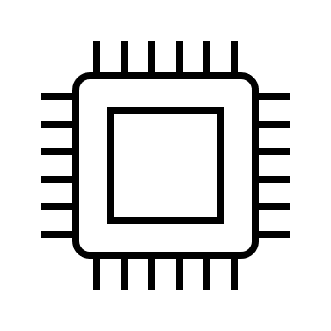


INTRODUCTION
PURPOSE
COMPONENTS
OVERVIEW
OF CAMERA SOFTWARE
CONCLUSION

Slide 4
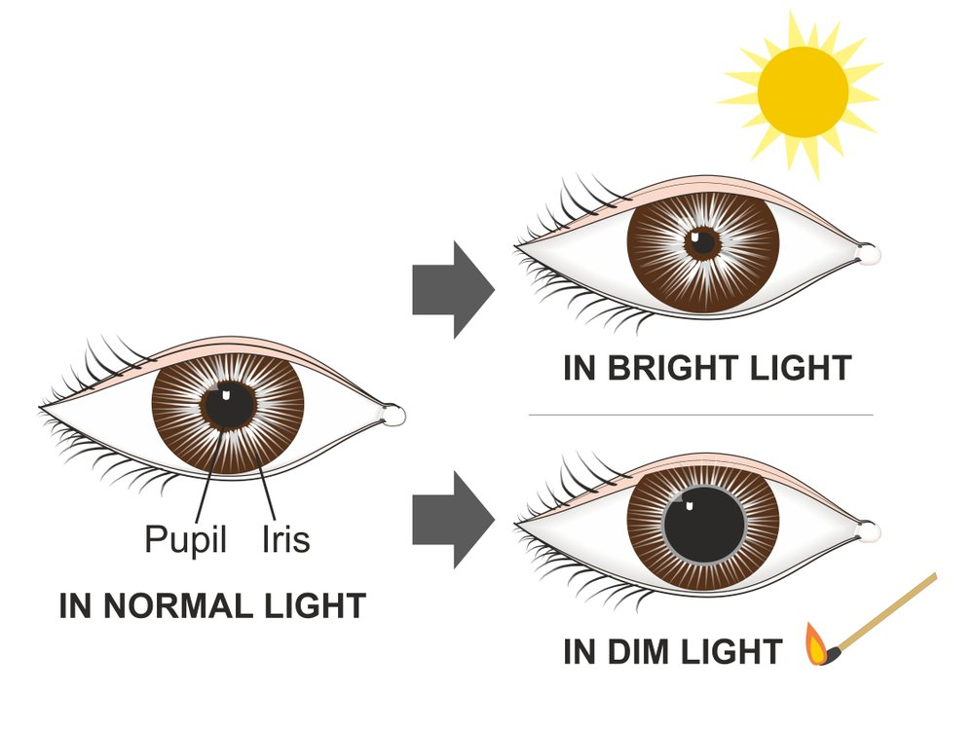
INTRODUCTION
pupillometer, is a device which measures the distance between pupils through visual stimuli.
The RAPD Pupillometer is an optical scanner which measures pupil size and pupil reactivity in Patients requiring ophthalmic or neurological pupil examinations.
It replaces the subjective and difficult to perform “swinging flashlight test” routinely conducted to screen for many different ophthalmic conditions.

Slide 5
NORMAL PUPIL RESPONSE TO LIGHT
RAPD EYE RESPONSE TO LIGHT

Slide 6
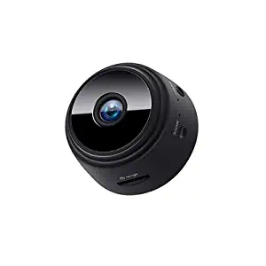
COMPONENTS
CAMERA
Resolution: 1080P video format
Viewing angle: 150 degrees motion detection
camera distance: 6 meters straight
Portable mobile hotpots used indoor/outdoor 150-degree super wide angle 6 hidden infrared lamps, lightless and 5m night vision range - APP remote control, mobile detection ,remote alarm, night vision/voice/Screenshots/clarity adjustments HD
Software: HDWificampro

Slide 7
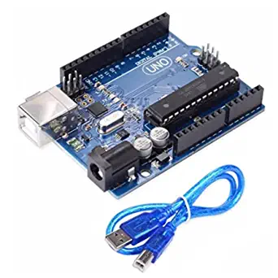
ARDUINO UNO
It is a board-based microcontroller (small computer on a chip) with facilities for processing data and I/O (input and output) pins for receiving and sending signals to devices.
It can be powered and programmed using a computer. Arduino contains a mini/micro or type B USB port that can be used to connect to a PC via the regular USB port, and the connection is done via a USB cable.
We are using arduino uno board to program the led flashes that are meant to be fall on the patient eye so we could diagnose the rapd (dilation and constriction sync of pupil)

Slide 8
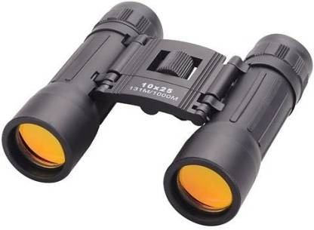
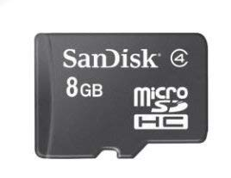
BINOCULAR EYE
we are going to use it to provide a closed vision to doctor so he could clearly see the constrictions and dilation of patient eye.
THE SANDISK
MicroSD cards offer an easy, affordable way to expand device's onboard memory.
Available in capacities from 4GB to 32GB, these cards give you additional storage space.
SanDisk microSD cards are shock proof, X-ray proof, temperature proof and waterproof.
We were using SanDisk of 8GB for storing and futher image processing.

Slide 9
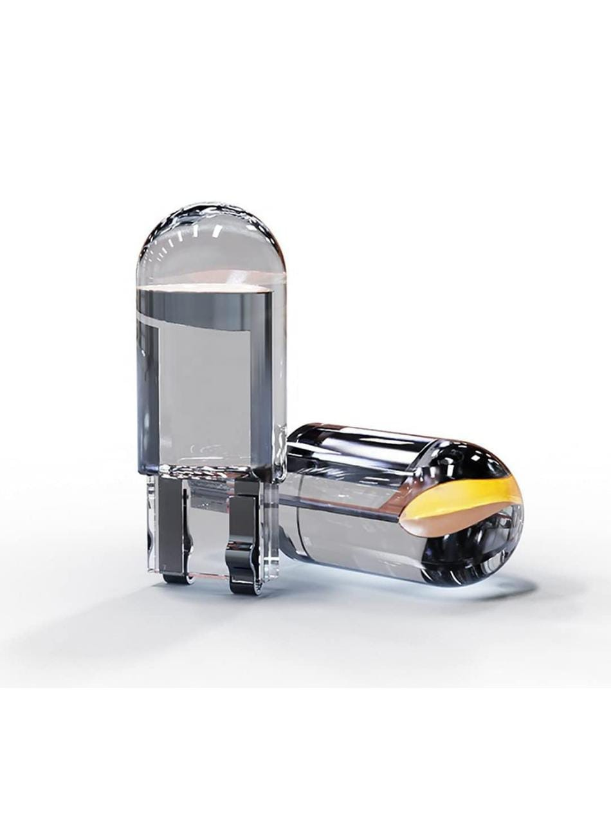
LED
High performance and quality: super bright LED light bulbs offer reliable lighting and visibility.
Huge brightness improvement compared to stock halogen bulbs, yet with lower energy consumption and stable performance, aluminum body for efficient heat dissipation.
We use two leds on either side of camera for dilating and constriction of pupil which is operated by Arudino.

Slide 10
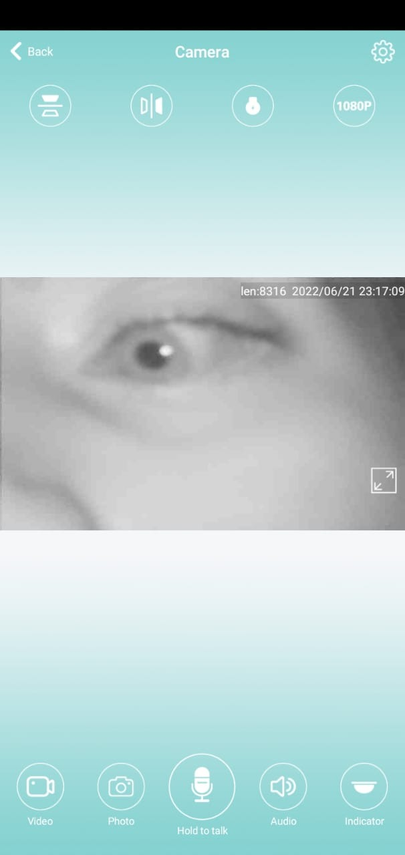
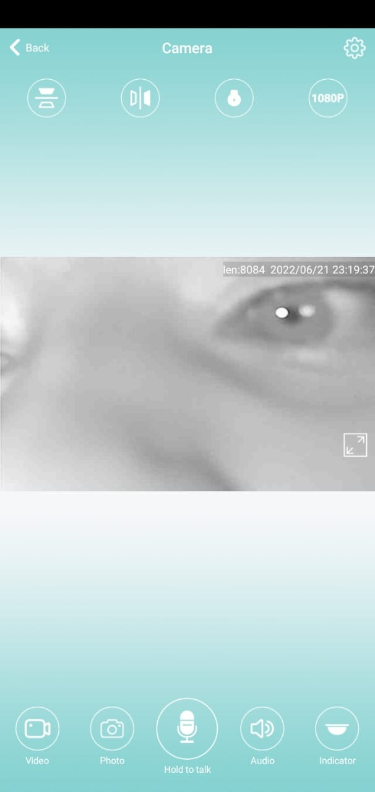
Normal pupil response constricted pupil response to light

Slide 11
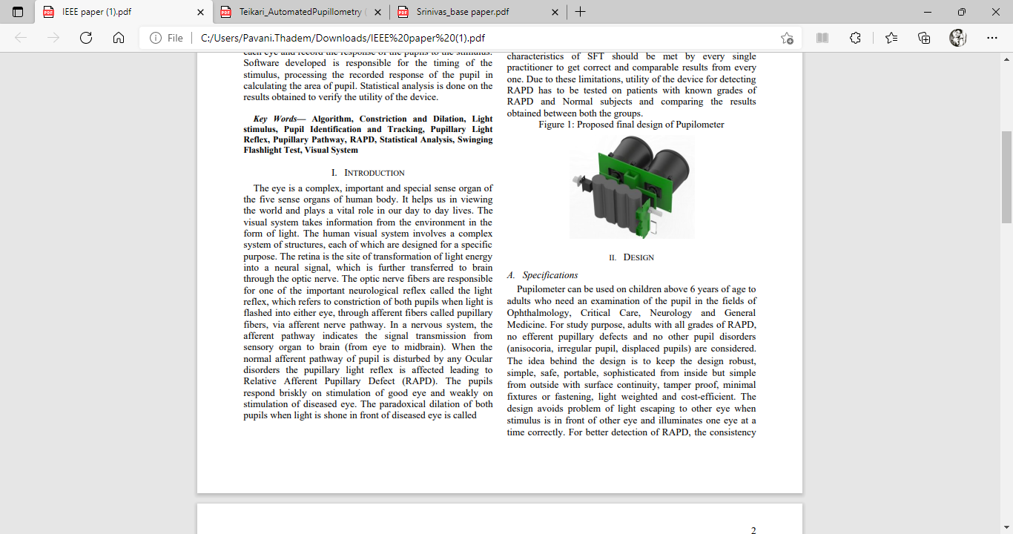
CONCLUSION
The proposed device is helpful in diagnosing the ocular disease called, RAPD. The idea behind the design is to keep the design robust, simple, safe, portable, sophisticated from inside but simple from outside with surface continuity, tamper proof, minimal fixtures or fastening, light weighted and cost-efficient. The design avoids problem of light escaping to other eye when stimulus is in front of other eye and illuminates one eye at a time correctly. The objective of device is to remove the human element in testing RAPD and differentiating between a Normal and RAPD patient only if the light stimulus falls within pupil area of the eyes.

Slide 12
THANK YOU

